Slide 1

Modeling epidemics using most probable paths
Dileep, Akanksha, Daniel, Lingyu

Slide 2
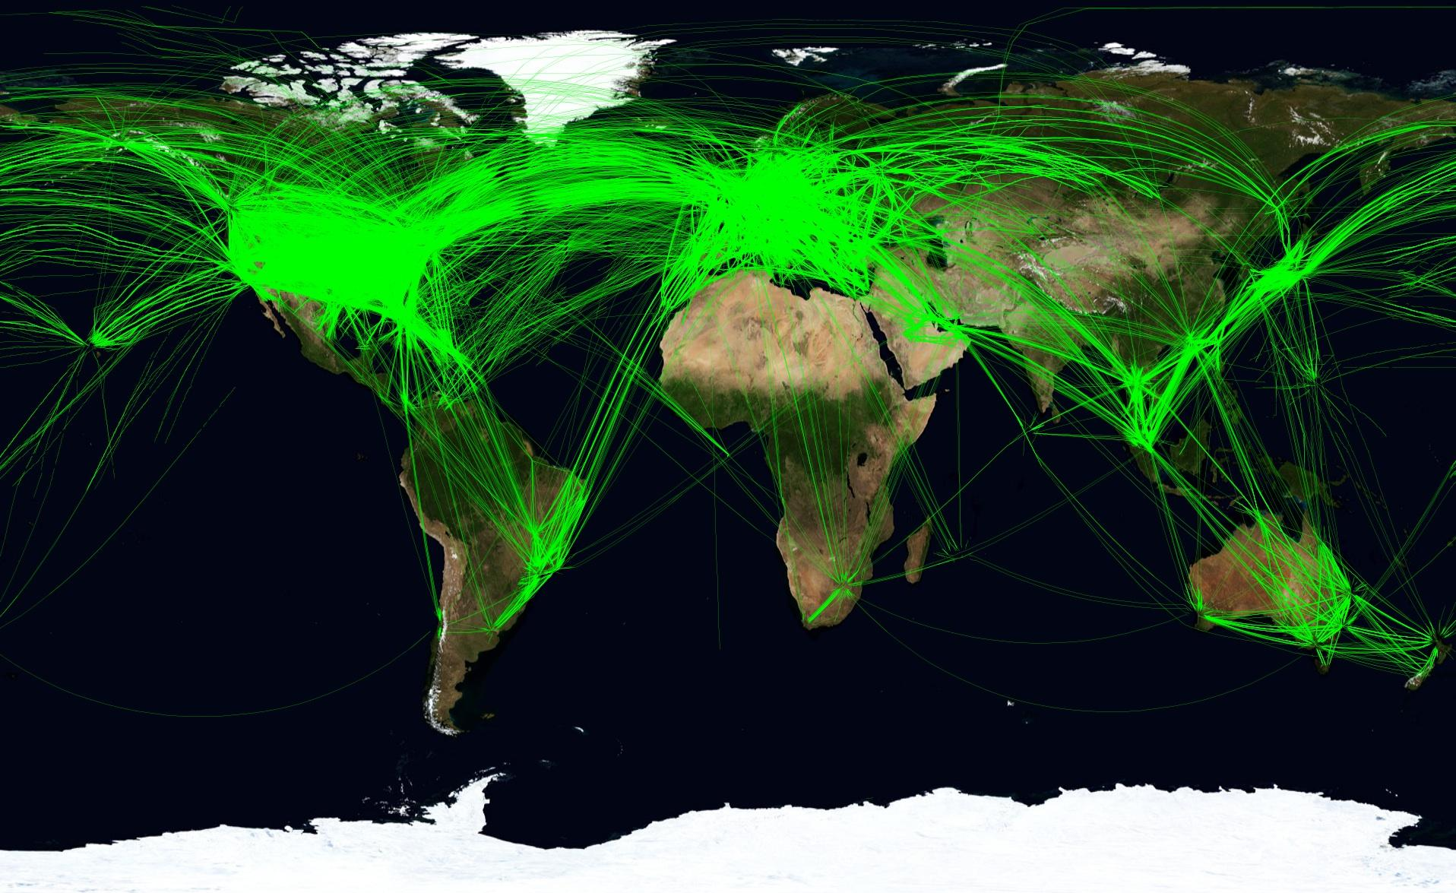
Background - Epidemics
Spread of epidemics due to various infectious diseases place significant burden on public health and global economies
Human mobility networks have become significantly more complex
The study of the networks for spread of the infection becomes essential to develop containment and mitigation strategies

Slide 3
Questions that influence course of action
Where did the pathogen emerge?
Where are the new cases to be expected?
When is the epidemic going to arrive at distant locations?
How many cases are to be expected?
Need of Computational methods to enable the study of spatially incoherent spreading patterns that do not bear metric regularity.

Slide 4
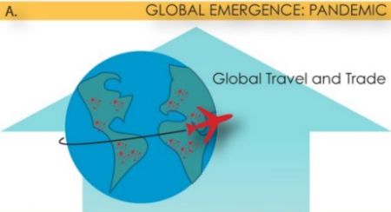
Classical Approaches
Models were build with the idea of geographic distance
The spread of the Black Plague through Europe would mostly depend on how far cities were separated geographically
Today large geographical separation does not necessarily mean harder to get to, i.e. Hong Kong - New York.

Slide 5
Objectives
Determine the relationship between epidemic arrival time and effective distance
Predict arrival times and spread of epidemic in distant locations
Simulation of epidemic outbreaks and identification of origin of outbreak

Slide 6
Data
Air traffic network of the European Union obtained from Eurostat http://ec.europa.eu/eurostat/statistics-explained/index.php/Air_transport_statistics
Airport geographic location information obtained from openflights http://openflights.org
Global H1N1 infection data for the period of 2008-present. Obtained from WHO http://apps.who.int/globalatlas/dataQuery/default.asp

Slide 7
Our Model
Air-traffic network of the European Union
Inter country distances:
Effective distance
Geographical distance
Relative Arrival Times are derived from mobility matrix (P) which is independent of the epidemic parameters

Slide 8
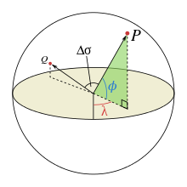

Geographical distance
Great circle distance
Shortest distance as measured along the surface of the earth
Distance between centroids of international airports of countries
Notes:
Do we need to add some description of the data? As to what it is and where it was obtained from? Also the difficulty in getting the data used in original paper.

Slide 9

Effective distance
A small fraction of traffic is effectively equivalent to a large distance
Shortest distance between nodes in the most probable path tree
Effective distance is asymmetric
Probability of a path
Effective length
Effective distance

Slide 10

EU Flow Network
Each circle (node) represents a country
Diameter of node is proportional to population size
Width and colors of line represent flow rates between nodes. i.e Green, Wide = high flow rate.

Slide 11
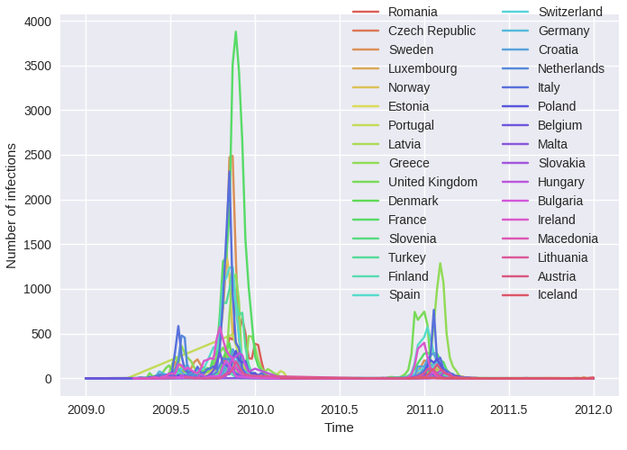
H1N1 Infections vs. Time
Sharp spike in 2009 marks the H1N1 epidemic
First appeared in Mexico in week 10
First cases appeared in the EU around week 18

Slide 12
Time-lapse of Infections

Slide 13
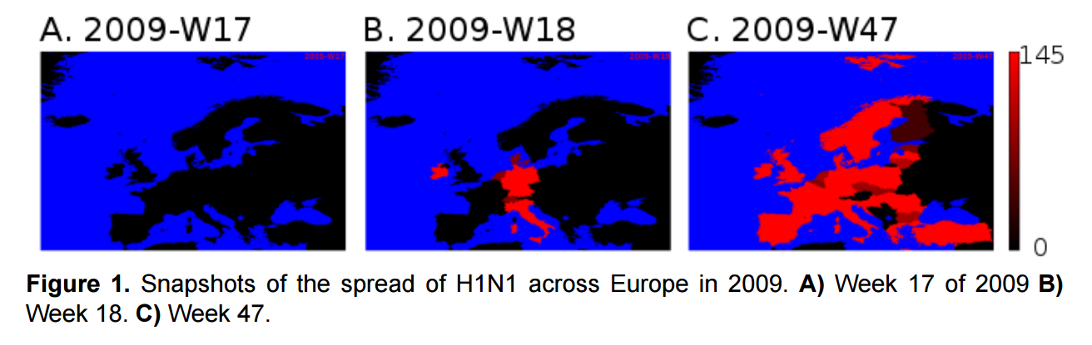
Time-lapse of Infections

Slide 14
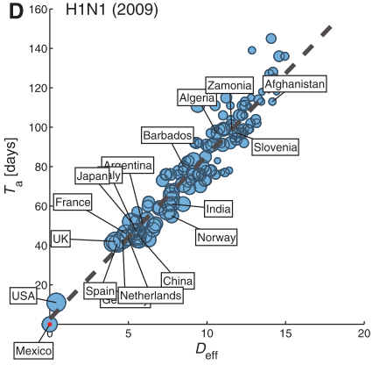
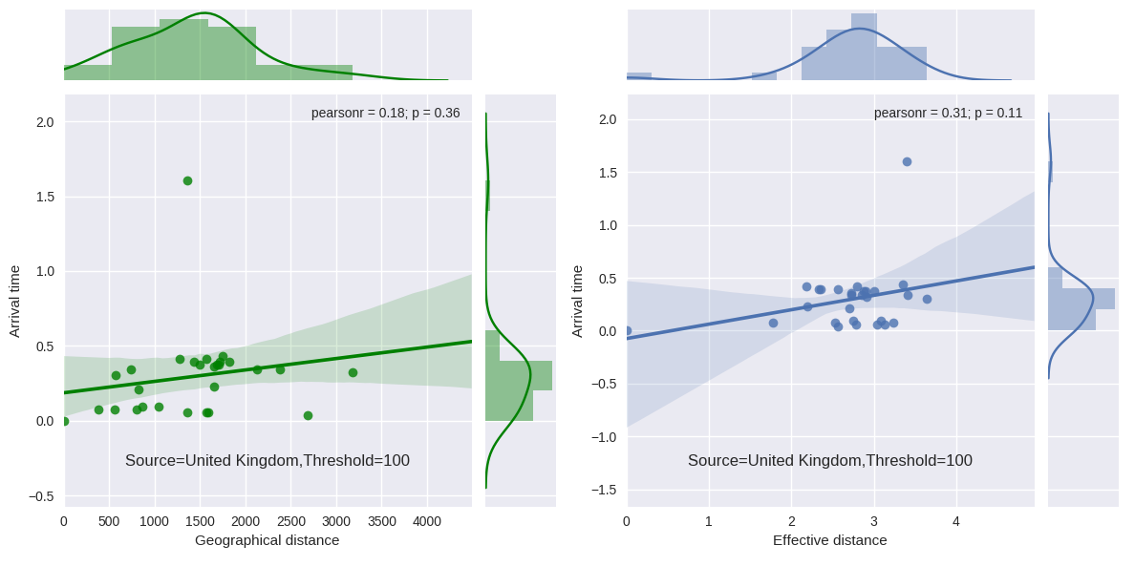
Linear regression plots
No significant correlations
Lack of variation in

Slide 15
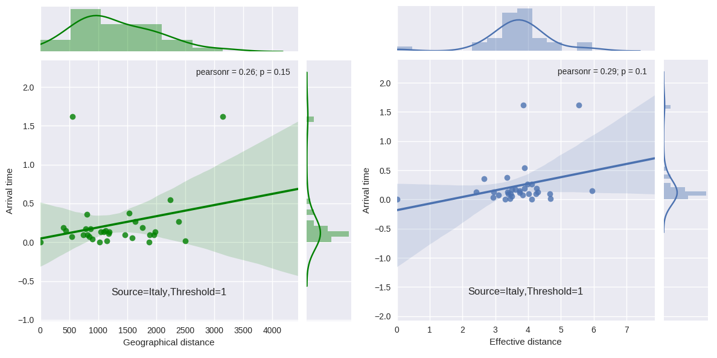
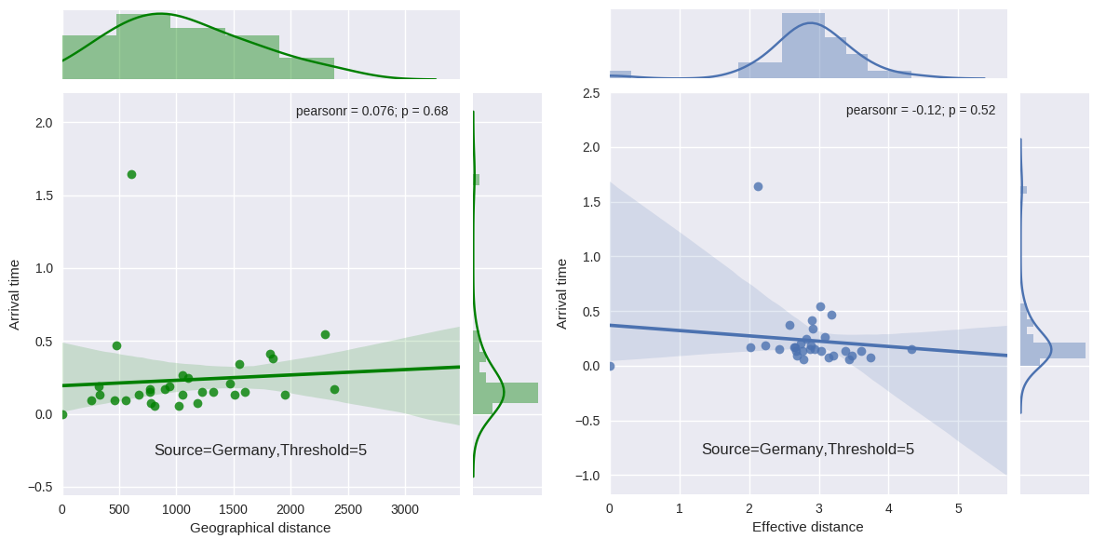
Ambiguity in source country
Could not identify single source country
Variation in infection arrival threshold identifies different source countries

Slide 16
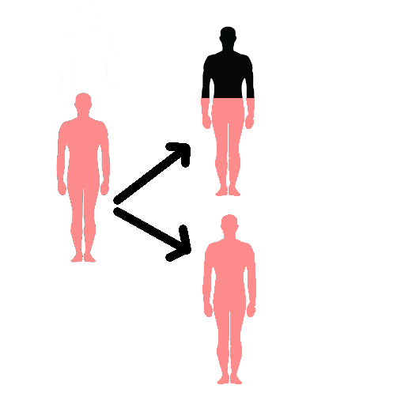
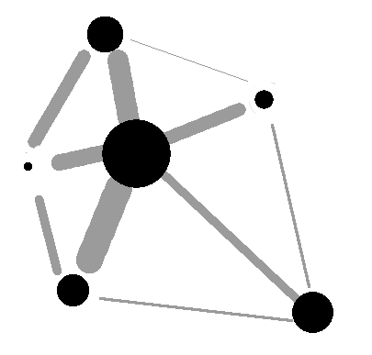

Simulation
Naive simulation condition:
Propagation of disease: R0=1.5 (deterministic)
200-1000 nodes, complete graph (every node is connected)
Population and flow follows exponential distribution

Slide 17
Simulation
Difficulties:
random.choice([0,0,0,1,1,0,0],14)
random.hypergeometric(ngood,nbad,nsample)

Slide 18
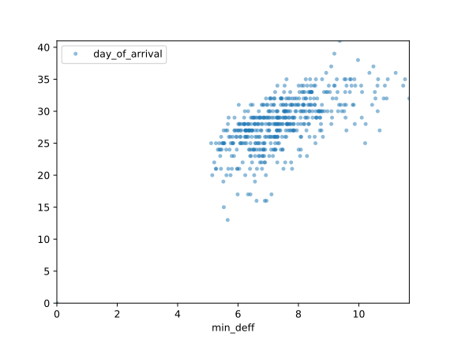
Simulation
R0=1.5 (influenza doubling/day)
r=2.8*10^-3 (daily global traffic ratio)

Slide 19
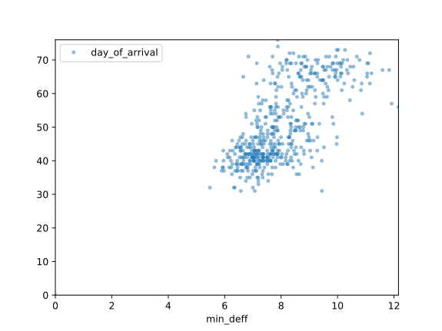
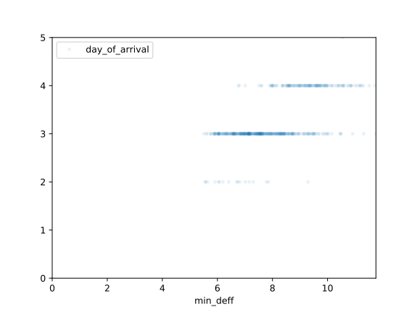
Simulation
R0=1.5 (influenza doubling/day)
r=2.8*10^-6 (daily global traffic ratio)
R0=100 (influenza doubling/day)
r=2.8*10^-3 (daily global traffic ratio)

Slide 20
Discussion
Could not obtain global traffic flow network - proprietary.
The network in reality is not isolated and is connected to other countries outside the EU
Countries in the EU are highly connected through good land transportation networks
H1N1 outbreak touched most of EU simultaneously since the countries within EU are connected strongly by land networks.
Simulation showed promising results under crude conditions.

Slide 21
Future Prospects
Simulation of H1N1 on the global air-traffic network
Counter Epidemic actions
Imposing quarantines in key airports to reduce spread of epidemic
Which nodes will be crucial for an epidemic with specific origin, infectivity and lethality.
Least amount of airports (and which ones) need to be quarantined to fully curtail spread of epidemic

Slide 22

Thank you
Questions?

